Slide 1
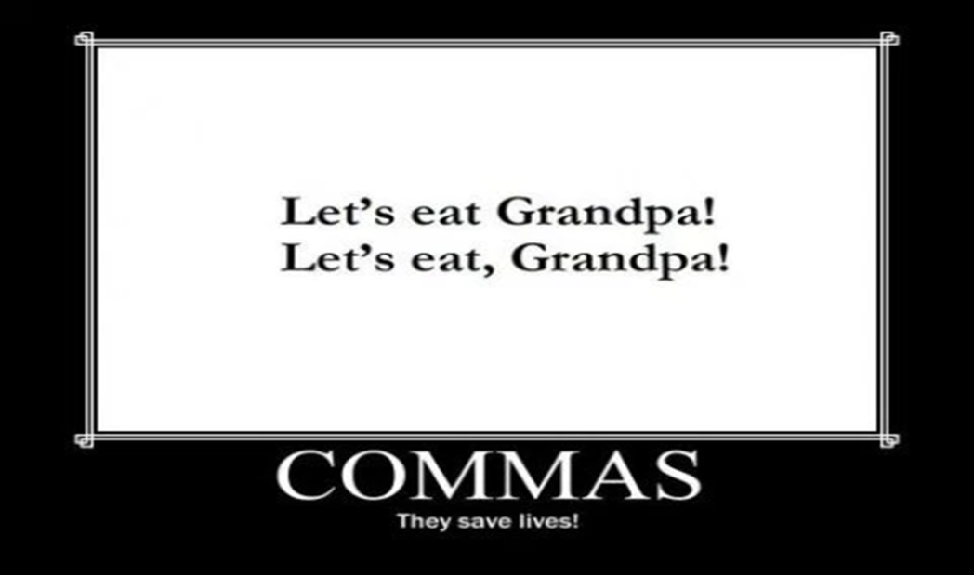
Punctuation
Kiszely Zoltán
BME GTK INYK
20 March 2018

Slide 2


Slide 3
Puzzle
You are a CIA agent whose job is to keep track of all the Russian spies in Melopolia. One day you receive this telegram from Washington:
”All the Russian spies, formerly residing in the Russian embassy, have been sent home.”
Is there anyone else for you to watch?

Slide 4
Contents
End marks: full stop/period, question mark, exclamation mark/point
Comma
Quotation marks
Semi-colon
Colon
Ellipsis mark
Apostrophe
Hyphen vs dash
Brackets / parentheses
Square brackets
Slash
Miscellaneous

Slide 5

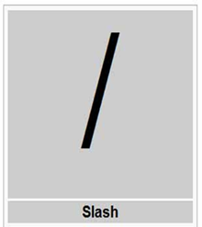
Square brackets

Slide 6
1. End marks
full stop / period
exclamation point/mark
  ratio of exclamation marks:
  in general English texts: 1/1000 words
  in academic English texts: 1/10,000 words
question mark

Slide 7
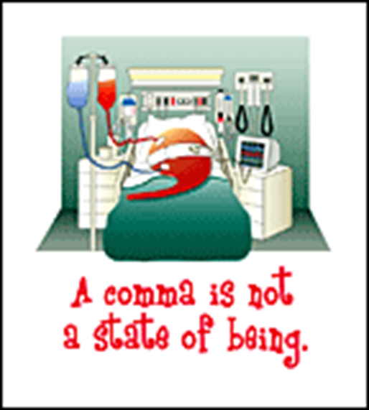
2. Comma
indicates a pause in a sentence

Slide 8

2. Comma – Hungarian vs English
Azt mondtam neki, hogy nem láttam tegnap az edzésen.
vessző a „hogy” előtt
I told him that I had not seen him at the training the day before.
no comma before ’that’
Notes:
Key Concept: Commas should be placed between each element within a list. This placement can help the reader to avoid confusion.

Slide 9
2. Comma – in a series
to divide items in a list
Last month, Alex dated Mary Ann Lee and Kim. (correct)
Last month, Alex dated Mary, Ann, Lee, and Kim. (correct)
Last month, Alex dated Mary Ann, Lee, and Kim. (correct)
She saw that he drank his wine, that he ate some salmon(,) and that he swallowed some pills after that. (correct)
Notes:
Key Concept: Commas should be placed between each element within a list. This placement can help the reader to avoid confusion.

Slide 10
2. Commas – in a series
Christina brushed her hair put on her pajamas and went to bed. (incorrect)
Christina brushed her hair, put on her pajamas(,) and went to bed. (correct)
She fell asleep and dreamed that she was a princess she kissed a frog and she rescued her prince. (incorrect)
She fell asleep and dreamed that she was a princess, she kissed a frog(,) and she rescued her prince. (correct)

Slide 11
2. Comma – subordinate clauses
If I bought a second-hand car I would have to take it to a mechanic every week. (incorrect)
If I bought a second-hand car, I would have to take it to a mechanic every week. (correct)
I would have to take it to a mechanic every week, if I bought a second-hand car. (incorrect)
I would have to take it to a mechanic every week if I bought a second-hand car. (correct)

Slide 12
2. Comma – introductory elements
Unfortunately we have not fixed it yet. (incorrect)
Unfortunately, we have not fixed it yet. (correct)
In our society we often need a diploma before we are hired for a job. (incorrect)
In our society, we often need a diploma before we are hired for a job. (correct)

Slide 13
2. Comma – parenthetical expressions
as a result, however, of course, for example, therefore, in fact, indeed etc.
I do not however remember his name. (incorrect)
I do not, however, remember his name. (correct)
However, this is not a good idea. (correct)
This is not a good idea, however. (correct)
BUT
However hard I tried, I couldn’t catch him. (correct)

Slide 14
2. Comma – tag questions
I’m stupid, aren’t I? (correct)
Let’s go to the cinema, shall we? (correct)

Slide 16
2. Comma –
Defining vs non-defining clauses
Donald Trump who is the President of the USA went to Cuba last week. (incorrect)
Donald Trump, who is the President of the USA, went to Cuba last week. (correct)
Donald Trump (who is the President of the USA) went to Cuba last week. (correct)
Donald Trump, who is the President of the USA, went to Cuba last week. (correct)
Donald Trump went to Cuba last week. (correct)

Slide 17
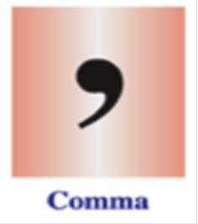
2. Comma –
Defining vs non-defining clauses
The man, who is the President of the USA, went to Cuba last week. (incorrect)
The man who is the President of the USA went to Cuba last week. (incorrect)
The man went to Cuba last week. (incorrect)
The man who is the President of the USA went to Cuba last week. (correct)

Slide 18
2. Comma –
Defining vs non-defining clauses
Donald Trump, who is the President of the USA, went to Cuba last week. (correct) (non-defining clause)
The man who is the President of the USA went to Cuba last week. (correct) (defining clause)

Slide 19
2. Comma –
Defining vs non-defining clauses
The population of Philadelphia now about 1.6 million has declined since 1950. (incorrect)
The population of Philadelphia, now about 1.6 million, has declined since 1950. (correct)

Slide 20
2. Comma –
Defining vs non-defining clauses
My brother who lives in Oslo likes roast beef.
(correct)
2. My brother, who lives in Oslo, likes roast beef.
(correct)
Difference?
1. I have at least two brothers.
2. I have only one brother.

Slide 21
Puzzle
You are a CIA agent whose job is to keep track of all the Russian spies in Melopolia. One day you receive this telegram from Washington:
”All the Russian spies, formerly residing in the Russian embassy, have been sent home.”
Is there anyone else for you to watch?
No, there isn’t.
”All the Russian spies, formerly residing in the Russian embassy, have been sent home.”

Slide 22
2. Comma – some extras
I have to pay $4250 by 30 June 1992 before I officially own my car. (incorrect)
I have to pay $4,250 by 30 June 1992 before I officially own my car. (correct)
I have to pay $4 250 by 30 June 1992 before I officially own my car. (correct)
I have to pay $4 250 by 30 June 1992 before I officially own my car. (correct)
I have to pay $4 250 by June 30, 1992 before I officially own my car. (correct)

Slide 23
2. Comma – some extras
The 70000 employees of the Postal Service handle millions of letters each year. (incorrect)
The 70,000 employees of the Postal Service handle millions of letters each year. (correct)
The 70 000 employees of the Postal Service handle millions of letters each year. (correct)
I live at 15 Amsterdam Avenue Toronto Canada M5S 1A1. (incorrect)
I live at 15 Amsterdam Avenue, Toronto, Canada M5S 1A1. (correct)

Slide 24
3. Quotation marks
’…’ single quotation marks (BR)
”…” double quotation marks (US)

Slide 25
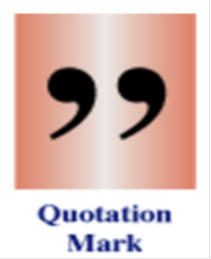
3. Quotation marks – Hungarian vs English
”Listen,” I said. ”Let’s get
out.”
”You punks clear the hell
out of here,” the
bartender said.
”I said we were going
out.” I said.
– Hagyd – mondtam. –
Menjünk innét.
– Menjenek innen a
fenébe, szarháziak –
mondta a csapos.
– Én mondtam, hogy
menjünk – vágtam
vissza.
Hemingway: The Light of the World

Slide 26
3. Quotation marks
Gavin said I am leaving. (incorrect)
Gavin said, ’I am leaving.’ (correct)
Gavin said, ”I am leaving.” (correct)

Slide 27
3. Quotation marks
The lifeguard shouted No ball playing in the water! (incorrect)
The lifeguard shouted, ’No ball playing in the water!’ (correct)
The lifeguard shouted, ”No ball playing in the water!” (correct)

Slide 28
3. Quotation marks
I can't believe you gave my favourite jacket to them Nick cried. (incorrect)
’I can't believe you gave my favourite jacket to them,’ Nick cried. (correct)
”I can't believe you gave my favourite jacket to them,” Nick cried. (correct)

Slide 29
3. Quotation marks
If today were a blackboard Barry said I'd erase it and start over. (incorrect)
’If today were a blackboard,’ Barry said, ’I'd erase it and start over.’ (correct)
”If today were a blackboard,” Barry said, ”I'd erase it and start over.” (correct)

Slide 30
September 24 in the USA
National Punctuation Day is a celebration of punctuation that occurs each year
founded by Jeff Rubin in 2004
promotes the correct usage of punctuation

Slide 31

4. Semi-colon
comma
semi-colon

Slide 32

4. Semi-colon
stronger than a comma
comma
semi-colon

Slide 33
4. Semi-colon
to separate items in a series when the items themselves contain commas
He's lived in Los Angeles, California, Kinston, North Carolina, Portland, Oregon, and Dallas, Texas. (incorrect)
He's lived in Los Angeles, California; Kinston, North Carolina; Portland, Oregon(;) and Dallas, Texas. (correct)

Slide 34
4. Semi-colon
to separate main clauses
I don't expect to be home until 6.30 don't call until that time. (incorrect)
I don't expect to be home until 6.30, don't call until that time. (incorrect)
I don't expect to be home until 6.30; don't call until that time. (correct)
I don't expect to be home until 6.30. Don't call until that time. (correct)
I don't expect to be home until 6.30, so don't call until that time. (correct)

Slide 35
5. Colon
to introduce a list, a quotation or an explanation
This is what you'll need to buy tomorrow a note book some pencils two pens and some paper. (incorrect)
This is what you'll need to buy tomorrow: a note book, some pencils, two pens(,) and some paper. (correct)
I found the following things in the bag a comb a perfume and a lipstick. (incorrect)
I found the following things in the bag: a comb, a perfume(,) and a lipstick. (correct)

Slide 36

6. Ellipsis mark
to indicate omissions in a quotation
to indicate pauses
  ’I wish …,’ his voice trailed off. (correct)

Slide 37
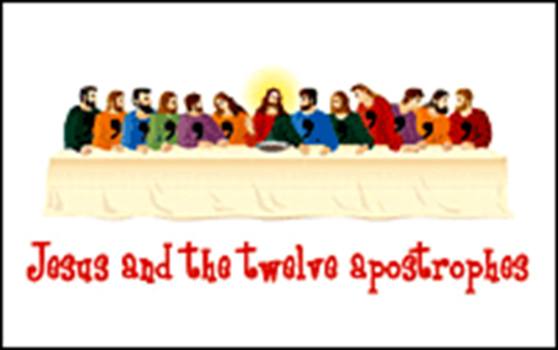
7. Apostrophe

Slide 38
7. Apostrophe
Everyones talking about Ken Follet’s novel. (incorrect)
Everyone’s talking about Ken Follet’s novel. (correct)
She is nobodys fool when money is involved. (incorrect)
She is nobody’s fool when money is involved. (correct)
Someone stole ten dollars from Bills pocket. (incorrect)
Someone stole ten dollars from Bill’s pocket. (correct)

Slide 39
7. Apostrophe
There are two 7s in 1776. (incorrect)
There are two 7’s in 1776. (correct)
There are three bs in ’bubble’. (incorrect)
There are three b’s in ’bubble’. (correct)
No ifs, no buts, go to sleep! (incorrect)
No if’s, no but’s, go to sleep! (correct)

Slide 40
7. Apostrophe
Los Angeles’s weather is warm. (correct)
The business’s customers filed suit. (correct)
Socrates’ ideas (correct)
OR
the wisdom of Socrates (correct)
Oedipus’ little problem (correct)

Slide 41
8. Hyphen vs dash
hyphen: to connect words
  mother-in-law (correct)
  My ten-year-old daughter has blue eyes. (correct)
dash: to separate sentence parts
  I suggest – no, I insist – that you stay for dinner. (correct)
  What would we do if Hitler – that monster – appeared among us? (correct)

Slide 42
9. Brackets, parentheses
parentheses = brackets
to separate extra information
  In my textbook (pp. 123-124) there are some frightening statistics. (correct)
to enclose numbers that signal items
  The three steps you need to do are to (1) study the title, (2) read the text and (3) study the headings. (correct)

Slide 43
10. Square brackets
to include explanatory words or phrases within quoted language:
Lew Perkins, the Director of Athletic Programs, said, “Pumita Espinoza, the new soccer coach [at Notre Dame Academy] is going to be a real winner.” (correct)

Slide 44
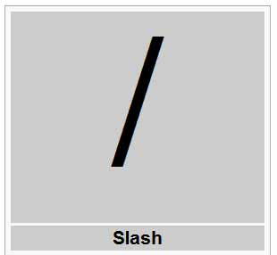
11. Slash
to indicate options
  We use a full stop/period at the end of most sentences. (correct)

Slide 45
12. Miscellaneous
Mr. (correct)
a.m. (correct)
Dear Joe, (correct)
Please open the window! (correct)
Could you open the window, please? (correct)
I haven’t read The Great Gatsby yet. (correct)
I haven’t read The Great Gatsby yet. (correct)
FAQ:
& = ampersand
@ = at
{ } = braces

Slide 46
Summary
A word of warning:
Internet-based punctuation checkers are not always reliable!
Always be more or less precise! ☺

Slide 47

Thank you.
Enjoy your day!

Slide 48
Bibliography
Strunk, W. J., & White, E. B. (1972). The elements of style. Boston: Allyn and Bacon.
https://owl.english.purdue.edu/owl
http://writing.garretson.info/PunctuationChecker
http://www.nationalpunctuationday.com/

