Slide 1


Using sources
27 February 2018

Slide 2
Sample items from Test 1
Which two of the following are almost never used in academic writing? 2 points
Rhetorical questions
The personal pronoun ‘I’ to refer to the author
The personal pronoun ‘we’ to refer to the author(s)
Colloquial expressions (‘get a raise’, ‘have a laugh’)

Slide 3
Sample items from Test 1
Which two of the following are almost never used in academic writing? 2 points
Rhetorical questions
The personal pronoun ‘I’ to refer to the author
The personal pronoun ‘we’ to refer to the author(s)
Colloquial expressions (‘get a raise’, ‘have a laugh’)

Slide 4
Sample items from Test 1
What is valued most in academic writing in English? 1 point
Using a standard writing style
Showing the breadth and depth of the author’s learning
Ensuring the reader understands the argument
Sounding objective throughout

Slide 5
Sample items from Test 1
What is valued most in academic writing in English? 1 point
Using a standard writing style
Showing the breadth and depth of the author’s learning
Ensuring the reader understands the argument
Sounding objective throughout

Slide 6
Sample items from Test 1
Which two of these are problems writers can have when trying to use synonyms in writing? 2 points
Synonyms can have slightly different meanings, so you might say something you did not mean to
Using too many synonyms can sound absurd
Synonyms can have slightly different meanings, so a skilled writer can use them to add extra meaning to a text
They can be pre-modified using adjectives
They are typical of informal speech

Slide 7
Sample items from Test 1
Which two of these are problems writers can have when trying to use synonyms in writing? 2 points
Synonyms can have slightly different meanings, so you might say something you did not mean to
Using too many synonyms can sound absurd
Synonyms can have slightly different meanings, so a skilled writer can use them to add extra meaning to a text
They can be pre-modified using adjectives
They are typical of informal speech

Slide 8
Sample items from Test 1
Which word is often used to start a sentence in academic writing in English? 1 point
A. So
B. Therefore
C. That’s why
D. Anyway

Slide 9
Sample items from Test 1
Which word is often used to start a sentence in academic writing in English? 1 point
A. So
B. Therefore
C. That’s why
D. Anyway

Slide 10
Contents
0. Reminder
1. What is referenced?
2. Why do we reference?
3. How do we reference? – format and language
4. How do we reference well?

Slide 11
0. Reminder
Culture and writing – Intercultural rhetoric
Impersonal language
Making claims
Relevance

Slide 12
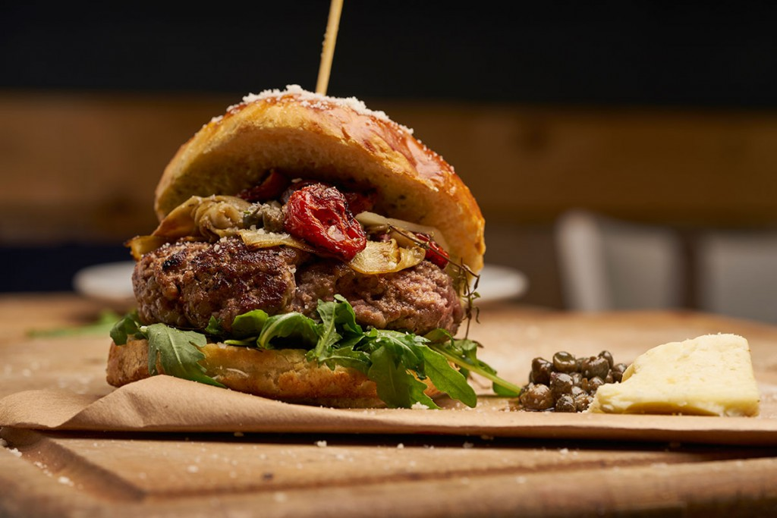
0. Reminder
impersonal language
honesty principle
relevance principle

Slide 13
How do you support your ideas?
Keywords:
acknowledgement: the act of admitting the existence of something
citation: a quotation from a source, or explicit reference to a source
credits: an acknowledgment of work done; recognition or approval for an act
documenting sources
footnotes: notes placed at the bottom of a page of a text that
comments on or cites a reference for a designated part of the text
parenthetical citation = in-text citation (Connor, 2002, p. 38)

Slide 14
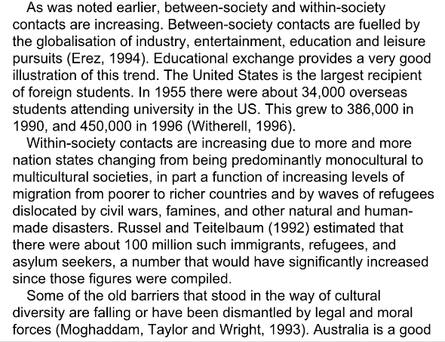
Academic texts contain a lot of references

Slide 15
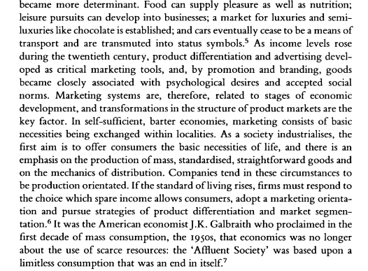
More references (different system):

Slide 16
1. What is referenced? Types of sources
Primary Sources – raw data, first hand | Research data sets (from surveys, experiments) in journal articles/conference papers, diaries, novels, government documents, works of art, reports
Secondary Sources – interpretation, discussion | Academic books (monographs), review journal articles, the discussion section of research articles, PhD theses (published/unpublished), reports, literary criticism, biographies
Tertiary Sources – collections, tools | Encyclopaedias, dictionaries, textbooks, databases, anthologies, indexes, literature reviews, library catalogues

Slide 17

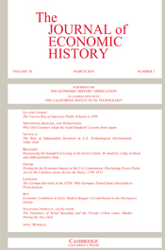



1. What is referenced?.
Some “serious” secondary sources:
Use ones like these:
Spot the tertiary source …

Slide 18
2. Why do we reference?
Reasons for (in-text) referencing:
Acknowledging – to show where the ideas, definitions, data, statistics etc. come from. Recognizing other people’s work.
Directing – showing the readers where to go for further details of a method, theory, idea etc.
Exemplifying – to give examples of writers and works who hold a point of view (e.g. on a debated area)
Comparing/Contrasting – to compare your ideas with other scholars, and to compare scholars with each other

Slide 19
2. Why do we reference?
Problems with a text full of references:
Why don’t other types of text (news articles, novels etc.) have references?
Some sections of academic texts have many references, while others have few. Why?
Popular non-fiction (e.g. history written for a general audience) often makes few or no in-text references to sources. Why?
It is very difficult to read them

Slide 20
2. Why do we reference?
Sources of tension:
Writers want to…
But writers have to…
… be original – say something new
… show their personal stance/viewpoint
… make claims, build an argument, “tell a story”
… acknowledge previous work
… use impersonal style
… provide evidence to support it

Slide 21
2. Why do we reference?
The following text sounds reasonable …
In my experience, after listening to a lecture for a while students tend to switch off. Some lecturers are better at keeping the students’ attention than others, by making their talks a bit more interactive. However, I’ve noticed that it is better not to put students “on the spot” as few students are comfortable answering questions in front of so many people.
… but why should you take my word for it?

Slide 22
2. Why do we reference?
But this way, it is more academic:
Research indicates that after exposure to between ten and twenty minutes of continuous lecturing, learning falls off rapidly (Pears, 1986). Luckily, several teaching practices counter this tendency. First, look for professors who ask rhetorical questions every ten minutes or so (Weaver and Cotrell, 1986) and who reinforce material by asking for non-threatening forms of participation such as a show of hands or volunteer speakers with examples con­firming or countering the material (Hunter, 1983).

Slide 23
2. Why do we reference?
Some knowledge is so well-known that a citation is not needed:
The Earth and other planets orbit the sun (Copernicus, 1543) and in turn moons orbit several planets (Galileo, 1610; Huygens, 1665).
The battle of Mohács took place in 1526.
Audience!

Slide 24
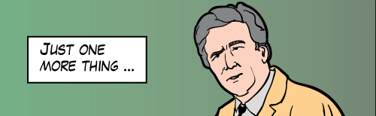
2. Why do we reference?
Citing other authors/data helps support your arguments. It does not “prove” them.
“Quotations rarely prove or disprove a point. Instead, they are used by the author of this text to ‘suggest” or ‘indicate’ a relationship between her or his own research … and that of another person – usually a recognized authority on this topic” (Hamps-Lyons, 2006).

Slide 25
3. How do we reference? Format
Integral references – author/work referred to is “in the foreground”
In an influential study, Chan (1968) found that the impact of shopping malls on cities is…
Non-integral references – author/work is “in the background”.
Shopping malls have significant influences on cities (Chan, 1968).

Slide 26
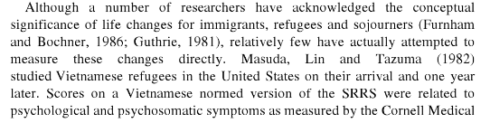
3. How do we reference? Format
Integral and non-integral reference:

Slide 27
3. How do we reference? Format
A third, bad type…
“I wrote a full bibliography at the end, all the books I referred to are there.”
it is very unclear how the references relate to what was said
you can be accused of plagiarism

Slide 28
3. How do we reference? Format
Direct quotation vs. indirect reference
Direct quotation uses the exact words of another author, and these must be in quotation marks.
As one of Hamsun’s characters put it: “But what really matters is not what you believe but the faith and conviction with which you believe…”⁴
If you make an indirect reference, you summarize or paraphrase what another author wrote, but in your own words.
Hamsun’s character valued strength of conviction even over the actual content of the belief.⁵

Slide 29
3. How do we reference? Format
Referencing systems: APA, MLA, Harvard, Chicago, Turabian etc.
Author-date systems
English cultures value clear, direct communication and are thus writer-responsible (Hinds, 1986). OR
Hinds (1986) coined the terms reader- and writer-responsibility.
Author-title systems
“Not having anything around to read is dangerous” (Houellbecq Platform, p. 56)
Numeric (endnote/footnote) system
Low-look cultures have a lower tolerance for staring⁶.

Slide 30
3. How do we reference? Format
Almost all referencing systems require that full details of the sources be given at the end of the text, in the bibliography / reference list / works cited.
E.g.: MLA:
In-text:
Parker notes … (160) / … bla bla bla (Parker 160).
Bibliography:
Parker, James. The First Years of Kenyan Democracy. Cambridge: Palladian Press, 1982.

Slide 31

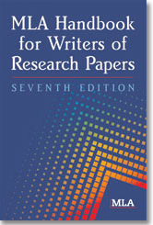
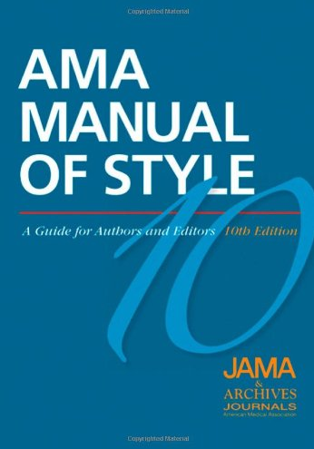
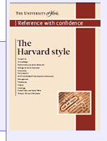
3. How do we reference? Format.
Referencing styles differ in things like:
- the order of information in the full reference
- using initials (Smith, B) or (Smith, Bob)
- “and” or “&”
Many guides are available:

Slide 32
How to reference your work? Video
https://www.youtube.com/watch?v=jG0Rgwcw8k8
When do we reference?
What is plagiarism?
When do you need to indicate page numbers in a reference?
Write down two verbs that you can use to introduce your reading.
What is the other name for List of references?
What should a reference to a book include?
If you indicate an online source, why do you think you need to indicate the date you downloaded it from the net?

Slide 33
3. How do we reference? Language
How to refer to other people’s work
Reporting verbs – claim, argue, explain, treat
Reporting nouns – survey, data, model, theory – literature, research, studies
According to …, In X’s view …

Slide 34
4. How do we reference? Language
Reporting verbs can indicate:
the author’s personal viewpoint
Smith (2013) doubts whether EU economic growth will continue.
your viewpoint regarding what the author says
Jones misinterprets the data in several important ways (Jones, 2002).
the author’s viewpoint regarding other literature
Penney (2015) dismisses feminist critiques as “vacuous”. (ostoba)

Slide 35
3. How do we reference? Language
Function | Weaker | Neutral | Stronger
Agreeing | admit, concede | accept, agree, acknowledge | support, endorse, concur
Disagreeing | condemn, doubt, question, wonder | disagree, challenge, question | attacks, criticizes, dismiss, reject, refute, discount, deny
Claiming (believing) | claim, suggest, hypothesize | claim, maintain, hold, believe | assert, insist, contend
Proving | indicate, suggest |  | prove, demonstrate, show
Proposing |  | recommend, suggest, advise, propose | urge, advocate
Studying | review | study, investigate, analyse | explore
Stating | imply | state | declare

Slide 36
3. How do we reference? Language
Schmidt (2010) describes the process of langauge acquisition.
Kon (2000) suggests that all poets are strongly influenced by their childhood. (indirect, tentative)
Lee (2006) states that problems arose earlier than previously thought. (direct)
Uvarov (2001) claims / asserts / contends / maintains / declares that the causes of the revolution can be traced back to the 18th century. (says sg is true directly; often used when others disagree)

Slide 37
3. How do we reference? Language
Van et al (2002) implies that other historians have misinterpreted the period. (suggests indirectly)
Patel (2002) argues that governments should continue to fund space projects. (he gives reasons for his view)
Greenberg (2001) stresses / highlights / emphasises the importance of …
In a latest article Morton (2012) explains how information technology is changing society.

Slide 38
3. How do we reference? Language
Reporting verbs…reporting what?
Speech : Friedberger (2005) says states that she has seen enough stray ponies.
Thought : Lorson (1996) thinks believes that it is important to get some sleep.
Actions : Kenzaburō Ōe (2003) investigated the changes in Japanese society after WWII.
Findings: Harris (1998) identified a link between spending behaviour and age.

Slide 39
3. How do we reference? Language
Don’t say “say” and ”think” – reporting verbs (speech)
“say” is sometimes used in academic writing, but there are many better (more formal and precise) alternatives
students often use the same 2-3 reporting verbs over and over again: typically “state”, “argue” and “suggest”
by using reporting verbs more creatively you can make your writing more interesting, show critical thinking about the field (and get better grades!)

Slide 40
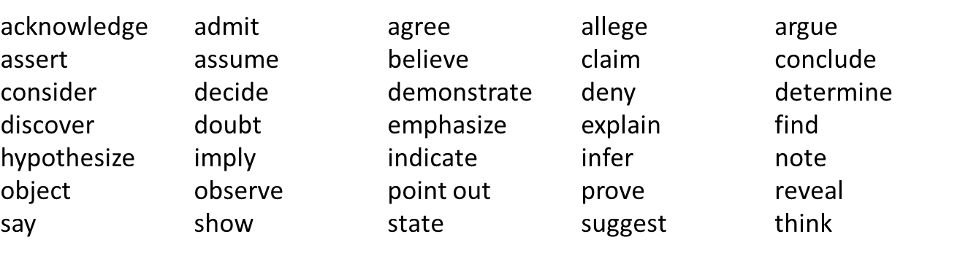
3. How do we reference? Language
Many (but NOT ALL) reporting verbs are followed by “that”:
reporting verb + that + subject + verb

Slide 41
3. How do we reference? Language
“that” can often be left out:
Both these sentences are grammatically OK:
He said that he had seen the exhibition
He said he had seen the exhibition.
However, omitting “that” is more typical of informal style than academic style. So don’t. Or rather ”do not.”

Slide 42
3. How do we reference? Language
as-clauses: usually show approval/agreement
as + author + reporting verb
As Steinberg demonstrated in his seminal 1968 paper, blood is indeed thicker than water.
as + (was) + past participle + by + author
As was noted by Kinder (2001) although many …

Slide 43
3. How do we reference? Language
“According to …”
to report the belief/claim of another person:
According to Jones (1972), optimism is essential to a happy life.
to report on findings:
According to a survey, 26% of Americans think the Sun goes round the Earth.
NEVER use it to refer to your own opinion:
X According to me/my opinion, I speak English well. X

Slide 44
3. How do we reference? Language
Grammar of reporting verbs: tenses
Reporting verbs are most frequently used in the present simple in academic English.
Thomson observes that most writers are unaware of their working method.
The past simple is used:
to describe a particular piece of research done
to show that the cited work/idea is old

Slide 45
3. How do we reference? Language
Common nouns in Academic English (reporting)
account, advice, analogy, analysis, approach, argument, aspect, assertion, assessment, attitude, author, challenge, claim, concern, conclusion, consensus, contradiction, criticism, data, debate, defence, definition, description, discussion, distinction, emphasis, evaluation, evidence, examination, example, explanation, hypothesis, idea, implication, insight, interpretation, investigation, literature, model, notion, observation, perception, perspective, proposition, question, reason, reasoning, review, suggestion, summary, survey, tendency, term, theory, viewpoint

Slide 46
3. How do we reference? Language
Reporting nouns
Ramirez’s suggestion that poets are influenced by their childhood is uncontroversial.
Lee’s statement that problems arose earlier than previously thought has been challenged.
Uvarov’s claim/assertion/contention that the causes of the revolution can be traced back to the 18th century is worth considering in some depth.
Watanabe’s implication that other historians have misinterpreted the period has caused some controversy.

Slide 47
4. How do we reference well?
Ways of showing your attitude to other’s work or the field as a whole
Choice of reporting verbs: claims, proves, shows
Choice of reporting nouns: proof, implication
Evaluative adjectives: weak, convincing, valuable
Negation: not … lacks …
Quantity expressions: Some evidence … Many studies …
Evaluative adverbs: Surprisingly, Significantly
Hedging devices (WEEK 3): may, might, seem

Slide 48
4. How do we reference well?
Showing a negative attitude to other’s work
Reporting verbs: claim, overestimate, overstate
Reporting nouns: contention
Evaluative adverbs: confusingly, surprisingly
Evaluative adjectives: incoherent, unconvincing, circumstantial, anecdotal (evidence)

Slide 49
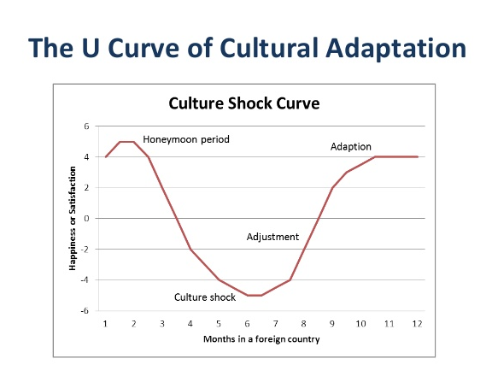
4. How do we reference well?
Example: the culture shock U-curve

Slide 50
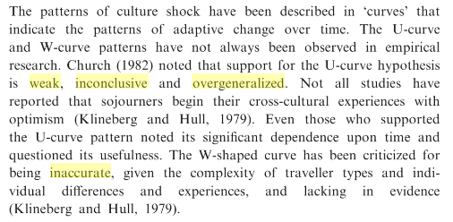
4. How do we reference well?
Criticism – find the negative expressions

Slide 51
4. How do we reference well?
Criticism

Slide 52
4. How do we reference well?
Lots of people say “The literature…”
An extensive body of literature exists on … (Feltz, 1973; Goff, 1999; Plone & Novak, 1997)
Research has shown that there are …
Contemporary empirical studies of culture …
Early writings on international relocation …
A review of the literature on skills training …
Uncertainty management has been examined extensively.
Most scholars who describe the role of uncertainty …

Slide 53
4. How do we reference well?
Two fun facts:
“view” is almost 3 times as common as “opinion” in academic writing
The phrase “thank you for your attention” is never used by native speakers of English at the end of a presentation or lecture. Just say simply “thank you”.

Slide 54
Summary
1. What is referenced?
Primary, secondary and tertiary sources
2. Why do we reference?
Avoiding plagiarism, acknowledgement
3. How do we reference? – format and language
APA, MLA
in-text citations, bibliography
wide variety of reporting verbs and nouns

Slide 55

Thank you for your attention. Enjoy your day!

