Slide 1


Setting the right tone
20 February 2018

Slide 2
Contents
A reminder from previous class
Culture and writing – Intercultural rhetoric
Impersonal language
Making claims
Relevance – Sticking to the point
Conclusion

Slide 3
Sample items from Test 1
Which two of the following are almost never used in academic writing? 2 points
Rhetorical questions
The personal pronoun ‘I’ to refer to the author
The personal pronoun ‘we’ to refer to the author(s)
Colloquial expressions (‘get a raise’, ‘have a laugh’)

Slide 4
Sample items from Test 1
Which two of the following are almost never used in academic writing? 2 points
Rhetorical questions
The personal pronoun ‘I’ to refer to the author
The personal pronoun ‘we’ to refer to the author(s)
Colloquial expressions (‘get a raise’, ‘have a laugh’)

Slide 5
Sample items from Test 1
What is valued most in academic writing in English? 1 point
Using a standard writing style
Showing the breadth and depth of the author’s learning
Ensuring the reader understands the argument
Sounding objective throughout

Slide 6
Sample items from Test 1
What is valued most in academic writing in English? 1 point
Using a standard writing style
Showing the breadth and depth of the author’s learning
Ensuring the reader understands the argument
Sounding objective throughout

Slide 7
Sample items from Test 1
Which two of these are problems writers can have when trying to use synonyms in writing? 2 points
Synonyms can have slightly different meanings, so you might say something you did not mean to
Using too many synonyms can sound absurd
Synonyms can have slightly different meanings, so a skilled writer can use them to add extra meaning to a text
They can be pre-modified using adjectives
They are typical of informal speech

Slide 8
Sample items from Test 1
Which two of these are problems writers can have when trying to use synonyms in writing? 2 points
Synonyms can have slightly different meanings, so you might say something you did not mean to
Using too many synonyms can sound absurd
Synonyms can have slightly different meanings, so a skilled writer can use them to add extra meaning to a text
They can be pre-modified using adjectives
They are typical of informal speech

Slide 9
Sample items from Test 1
Which word is often used to start a sentence in academic writing in English? 1 point
A. So
B. Therefore
C. That’s why
D. Anyway

Slide 10
Sample items from Test 1
Which word is often used to start a sentence in academic writing in English? 1 point
A. So
B. Therefore
C. That’s why
D. Anyway

Slide 11
1. Reminder
Cohesion vs coherence
Cohesive devices
  Reference
  Substitution
  Ellipsis
  Lexical relationships
  Linking words

Slide 12
1. Reminder
Reference:
"Some guys arrived. They seemed angry." (anaphora⬅)
"Listen to this: John's getting married." (cataphora➔)
Substitution: "I haven't got a pen. Do you have one?"
Ellipsis: "Where did you see him? _ In the street."
Lexical relationships:
  - general to specific: "The flowers were lovely. She liked the tulips best."
  - repeated forms: "Jack arrived. Jack was cross."
  - comparison: "That house was bad. This one is even worse.”
  - synonyms: ”This guy is very bright and that one is smart too.”
Linking words: "I left early, but Mark stayed till the end."

Slide 13
1. Reminder
Foreign students’ essays in English:
grammar – OK
vocabulary – OK
cohesive devices – OK
effect on native speakers – not OK
Why?
Tone: topic for today

Slide 14
2. Culture and writing: Tone, genre and rhetoric
tone: attitude of a writer toward the subject or the audience (vocabulary, grammar, relevance, structure)
genre (journal article, essay): kind, category or sort, especially of literary or artistic work (the rules of the game)
rhetoric (Aristotle): inventio (invention); memoria (learning the text); dispositio (arrangement); pronunciatio (delivery); elocutio (style) (strategies to win the game)
different cultures have different strategies for convincing the reader
what works in one culture may fail in another

Slide 15
2. Culture and writing
At that time of the year I was not studying enough to pass my courses in school. And all the time I was asking my cousin to let me ride the bicycle, but he would not let me. But after two weeks, noticing that I was so much interested in the bicycle, he promised me that if I pass my courses in school for that year he would give it to me as a present. So I began to study hard. And I studied eight hours a day instead of two. My cousin, seeing me studying that much, was sure that I was going to succeed in school. So he decided to give me some lessons in riding the bicycle. After four or five weeks … I finally knew how to ride it. And the finals in school came and I was very well-prepared for them so I passed them. My cousin kept his promise and gave me the bicycle as a present. And till now I keep the bicycle in a safe place, and every time I see it it reminds me how it helped pass my courses for that year.

Slide 16
2. Culture and writing
Even though there may be one or two disadvantages to living with an American family, the advantages far outweigh them. By taking part in a homestay program, the student has an excellent opportunity to learn about American customs. He will find out how to behave in different social situations such as parties and ceremonies and how to dress on these occasions. Also, he will learn about many other aspects of the American way of life, such as the way schools are run in the United States. With a family close by, he can ask questions about attendance rules and school costs. The family will make certain that he becomes acquainted with this new way of life, and soon he will feel at home.

Slide 17
2. Culture and writing
At that time of the year I was not studying enough to pass my courses in school. And all the time I was asking my cousin to let me ride the bicycle, but he would not let me. But after two weeks, noticing that I was so much interested in the bicycle, he promised me that if I pass my courses in school for that year he would give it to me as a present. So I began to study hard. And I studied eight hours a day instead of two. My cousin, seeing me studying that much, was sure that I was going to succeed in school. So he decided to give me some lessons in riding the bicycle. After four or five weeks … I finally knew how to ride it. And the finals in school came and I was very well-prepared for them so I passed them. My cousin kept his promise and gave me the bicycle as a present. And till now I keep the bicycle in a safe place, and every time I see it it reminds me how it helped pass my courses for that year.

Slide 18
2. Culture and writing
Even though there may be one or two disadvantages to living with an American family, the advantages far outweigh them. By taking part in a homestay program, the student has an excellent opportunity to learn about American customs. He will find out how to behave in different social situations such as parties and ceremonies and how to dress on these occasions. Also, he will learn about many other aspects of the American way of life, such as the way schools are run in the United States. With a family close by, he can ask questions about attendance rules and school costs. The family will make certain that he becomes acquainted with this new way of life, and soon he will feel at home.

Slide 19
2. Culture and writing
Even though there may be one or two disadvantages to living with an American family, the advantages far outweigh them. By taking part in a homestay program, the student has an excellent opportunity to learn about American customs. He will find out how to behave in different social situations such as parties and ceremonies and how to dress on these occasions. Also, he will learn about many other aspects of the American way of life, such as the way schools are run in the United States. With a family close by, he can ask questions about attendance rules and school costs. The family will make certain that he becomes acquainted with this new way of life, and soon he will feel at home.

Slide 20


2. Culture and writing
Intercultural rhetoric
“it examines differences and similarities in writing across cultures” (Connor, 2003, p. 218)

Slide 21
2. Culture and writing
research on Hungarian and American students’ essays (M. Godó, Á. 2008)
30 Hungarian university students and 30 US students -- an essay on genetic engineering
inquired about the position of the thesis statement in the essays

Slide 22
2. Culture and writing: Position of thesis statement
(M. Godó, Á. 2008)

Slide 23
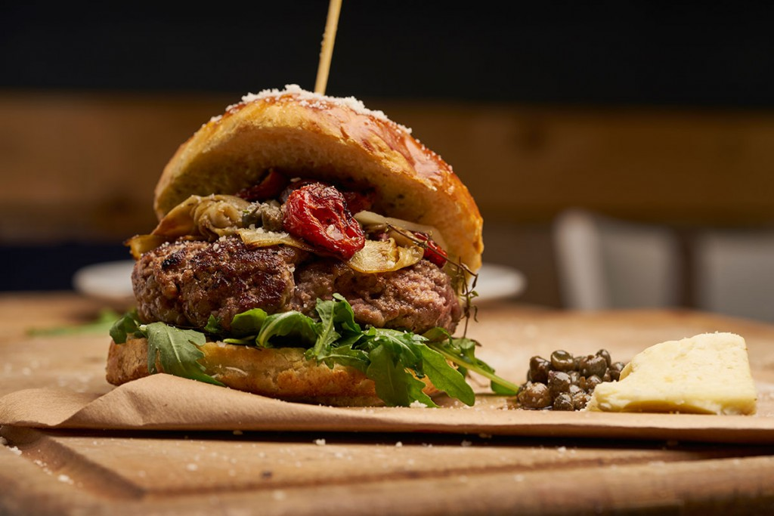

Slide 24
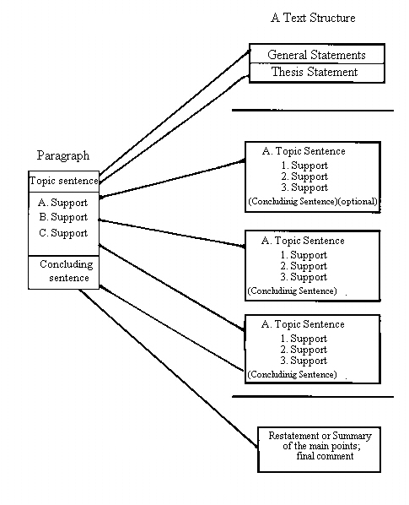

Slide 25
2. Culture and writing: Thesis statement
somewhere in an essay there should be a sentence which sums up the point of the text – a thesis statement
the point of the writing
“in a nutshell”
if no clear thesis statement: “so what?”

Slide 26
2. Culture and writing: Strong types of thesis statement
“Sugar is bad for teeth”.
“The results of this study show that sugar is bad for teeth”
“People who eat less sugar have better teeth, therefore sugar is bad for teeth”
“To protect teeth, eat less sugar”

Slide 27
2. Culture and writing: Weak types of thesis statement
“This essay/research is about the effects of sugar on teeth”
“Sugar has both advantages and disadvantages”
“Is sugar bad for your teeth?”
“Is sugar bad for teeth? Yes.”

Slide 28
2. Culture and writing: Position of thesis statement
Introduction: tell the reader what you are going to argue, then present the evidence to convince him
Body: ???
Conclusion: discuss the situation and evaluate the evidence, then tell the reader your conclusion at the end

Slide 29
2. Culture and writing: Non-typical “Anglo-Saxon” rhetorical pattern
Introduction
  Long description of situation, demonstrating the writer’s great knowledge of the topic “The first currency used in Hungary was the denarius in 955…”
  Questions “Will the continued weakening of the forint lead to price inflation?, Does it matter?”
Body: describing the topic, answering the questions, (sometimes with evidence)
Conclusion: a claim is presented based on the above (maybe)

Slide 30

2. Culture and writing: Typical “Anglo-Saxon” rhetorical pattern
Introduction
  Start with a short background to the claim
  Make the claim (clearly, in the first paragraph)
  Outline what the arguments for the claim will be
Paragraph 1 – argument for claim, with evidence
Paragraph 2 – argument for claim, with evidence
Paragraph 3 – argument for claim, with evidence
Conclusion – summarize arguments, restate claim

Slide 31
2. Culture and writing: Hungarian vs American education
Classical Humanism
preserving and passing on cultural traditions without re-interpreting or re-evaluating it
lexical knowledge (lots of facts) is highly valued – a basic source of intellectual prestige
Progressivism
the value of individual experience and interpretation
providing individuals with the chance to develop their capacities and personalities

Slide 32
2. Culture and writing: Other academic cultures
German: more digressions in texts – the writer might discuss other “less relevant” topics then go back to the point
French: data is most important – argument is secondary, or there is no argument OR examine all aspects of a question, without taking a position until the conclusion
Spanish: longer sentences, much less explicit (less “leading the reader”)
East Asian: avoid direct persuasion or argument, important to save reader’s face

Slide 33
2. Culture and writing
intercultural rhetoric
different cultures have different strategies for convincing the reader
thesis statements

Slide 34
3. Impersonal language
traditionally, academic writing in English uses impersonal forms: the writer is “hidden”
for example: no first person “I”
for many years: using “I” in English-language academic writing was forbidden
writers could supposedly address their subject more clearly and objectively

Slide 35
3. Impersonal language: Breaking the rules
in some academic fields – e.g. Economics, Psychology or Sociology – many authors break this “rule”: lots of “I” and “we”
writers usually use the first person in certain parts of the text, e.g.
  when outlining what they will argue
  in the preface
  when making an original claim
when English academic authors use “I” they deliberately and consciously break the rules
the writer stays hidden most of the time, but when s/he emerges the reader will pay more attention

Slide 36
3. Impersonal language: “I” versus “we”
some academics write “we”, not “I” – (in some types of sentence).
Reasons:
the text has two or more authors
a way of distancing themselves from the text

Slide 37
3. Impersonal language: “I” versus “we”
Problems:
Who exactly does “we” (our, us) refer to?
  Is it the author(s)?
  “In chapter 2, we review the literature on social….”
  Is it the author and the readers?
  “In this diagram, we can see the differences…”
  Is it all mankind?
  “If we are to survive, we must learn to tolerate…”
  Is it the Hungarians?
  “In our history, we have faced terrible problems”

Slide 38
3. Impersonal language: Depersonalizing your text: Some examples
“We will compare currency rates and GDP …”
“This essay compares currency rates …”
“In the first diagram, we can see a triangular …”
“Diagram 1 shows a triangular …”
“We should remember that …”
“It is important to note that …”
“In our days we face many environmental problems …”
“Environmental problems are a global …”

Slide 39
3. Impersonal language: Depersonalizing your text: Find impersonal alternatives
“azt láthatjuk, hogy …”
    “we can see that …”
    “it can be seen that …”
    “it is clear that …”
“E dolgozatban nem áll módunkban …”
- In this thesis we are not able to …
- It is not possible in this thesis to …

Slide 40
3. Impersonal language: Depersonalizing your text
The words below are rather informal and vague. Find some alternatives:
Nowadays everyone has access to the internet.
Access to the internet has become widespread.
Some people think that guns should be banned.
One view is that guns should be prohibited.
Most people in China still live in poverty.
The majority of the population of China still live in poverty.

Slide 41
3. Impersonal language: “It…” clauses
a formal way to emphasize a point: using an “it-” clause
several structures are used:
1. it is + adjective + (to infinitive) + that …
It is important to note that these expressions often introduce a new idea.
2. it + modal + passive verb + that …
It should also be emphasized that such structures are impersonal.
3. it is + worth + … ing + (that)
It is worth remembering that practice is needed.

Slide 42
3. Impersonal language: “It…” clauses
I want to note that there will be 3 mid-term tests in this subject.
It should be noted that there will be 3 mid-term tests in this subject.
We should remember that in 1973 crude oil cost only $2 per barrel.
It is worth remembering that in 1973 crude oil cost only $2 per barrel.
I think that the students’ high level of motivation is interesting.
It is interesting that the students were all highly motivated.

Slide 43
3. Impersonal language: Passives
we don’t know, or don’t care who did it
Compare:
Passive forms are commonly used in scientific writing.
Writers commonly use passive structures in scientific writing.
some manuals: do not overuse the passive
still, the passive is a useful tool for producing an impersonal tone

Slide 44
3. Impersonal language: Passives
Try to translate the following, without using “we”:
mint ahogy korábban említettük
As (it was) mentioned previously …
XYZ-t együttesen Teracom néven említjük
XYZ will be collectively referred to as Teracom …
Példaként említjük …
For example, it should be noted that …

Slide 45
3. Impersonal language: Nominalisation
Many people in the UK think that when more and more immigrants come to Britain then more British people will lose their jobs. There is no data to prove this, though.
The widespread belief that increasing immigration to the UK leads to an increase in unemployment has not been proven by data.

Slide 46
3. Impersonal language
breaking the rules -- ”I” vs ”we”
depersonalisation
”It …” clauses
passives
nominalisation

Slide 47
4. Making claims
academic writing in English is often structured around claims
related words: argument, opinion, thesis statement, generalisation

Slide 48

4. Making claims: Honesty principle
honesty principle: only say (or write) that for which you have evidence (Hamp-Lyons & Beasley 2006)
in writing, we often have to make generalisations, but it is important not to exaggerate – to make a sweeping generalisation or sweeping claim
e.g. “All trains in Britain are late.”
”The punctuality of trains in Britain is worse than that in many other western European rail networks.”
What is the solution?

Slide 49
4. Making claims: Hedging
Reasons:
1. Because your claim might turn out to be wrong. You don’t want to look silly later.
2. Because you don’t want to directly criticize another scholar – it is rude.
3. To avoid responsibility for the factuality of some information – shift the blame.

Slide 50
4. Making claims: Hedging
Compare:
I am playing tennis on Friday.
I might play tennis on Friday.
The results of the survey prove that the theory is correct.
The results of the survey appear to indicate that the theory is sound, but further testing is required.

Slide 51
4. Making claims: Hedging
Some statements are factually proven, or common knowledge, and do not require hedging:
e.g. Mercury is the closest planet to the Sun.
Others need to be hedged:
e.g. Eating oily fish makes you live longer.
  Eating oily fish may make you live longer.

Slide 52
4. Making claims: Hedging
Adverbs, adjectives and adverbial phrases can often make a sentence more tentative (or less “absolute”)
likely, essentially, (most) often, virtually, usually, typically, more or less, to a certain extent, relatively, apparently, seemingly, perhaps, possibly, common

Slide 53
4. Making claims: Hedging
Modal verbs express more or less certainty:
may, might, could, would, should
“Tentative” verbs distance a writer from a claim:
e.g. seem, indicate, suggest, appear,
This method would appear to be the most suitable.

Slide 54
4. Making claims: Hedging (practice)
Crime is caused by poor education.
Poor education may be a reason for crime.
A team of Hungarian scientists have found a way to generate electricity from paprika.
A team of Hungarian scientists seem to have found a way to generate electricity from paprika.
Global warming will cause the sea-level to rise.
Global warming appear to be a possible explanation for the rising sea-level.

Slide 55
4. Making claims
honesty principle
hedging

Slide 56
5. Relevance principle
Hamp-Lyons & Beasley 2006
facts and information that are relevant to the general topic of your essay (e.g. the European single currency) may not be relevant to the particular argument you are trying to convince the reader of.
if you are discussing the catering industry in Budapest, and mention that smoking is banned in public places in Hungary, you do not have to state that it was due to an amendment in April 2011 to Act XLII of 1999…

Slide 57
5. Relevance principle
in theory, all information in English essays, journal articles and chapters in academic books must be relevant to the aim of the text
to prove the claim made in the thesis statement at the start
there is low tolerance for simply demonstrating knowledge
“This is an essay, not an encyclopaedia article,” writing instructors suggest
this is bad news for students who want to recite a lot of facts they have learnt when writing an essay

Slide 58
Summary
peculiarities of Anglo-Saxon rhetoric
make a (tentative) claim at the start of the essay, then try to prove it
being impersonal, honest and relevant is a good way to make your reader believe you your claim – this is rhetoric (strategy to win the game)

Slide 59
Bibliography
Connor, U. (2003). Changing currents in contrastive rhetoric: Implications for teaching and research. In Kroll, B. (Ed.). Exploring the dynamics of second language writing (pp. 218-241). Cambridge: Cambridge University Press.
Hamp-Lyons, L. and Beasley, B. (2006). Study Writing: A Course in Writing Skills for Academic Purposes. Cambridge: Cambridge University Press.
Kaplan, R. B. (1966). Cultural thought patterns in intercultural education. Language Learning 16, 1-20.
Magnuczné Godó, Á. (2008). Cross-cultural aspects of academic writing: A study of Hungarian and North American college students’ L1 argumentative essays. In: R. Monroy-Casas (Ed.) Academic writing: The role of different rhetorical conventions. IJES Monograph Editum: University of Murcia. 65-112.

Slide 60

Thank you. Enjoy your day!

