Slide 1


How texts hang together: Cohesion in academic writing
13 February 2018

Slide 2
About the three tests once more
three tests during semester
each test can be rewritten once (only on pótlási hét – first week of exam period)
test dates: Test 1: 6 March; Test 2: 10 April; Test 3: 15 May
grading policy: 1. Pass all three individually (passmark: 50%); 2. Average counted
course material: lecture materials (slides etc.) presented during the lectures, extra material provided by the lecturers – ALREADY ON INYK WEBSITE
http://inyk.bme.hu/tananyag/tananyagok/angol/english-for-economic-and-social-sciences-english-b2 (eess18)

Slide 3
Contents
A reminder from previous class
Types of cohesion in a text
Cohesion vs coherence
Cohesive devices 1: Reference, substitution, ellipsis, lexical relationships
Cohesive devices 2: Linking words
Exercises

Slide 4
1. A reminder
Main features of academic writing
Some peculiarities of academic writing

Slide 5

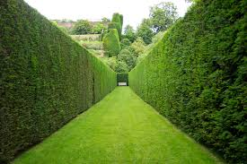

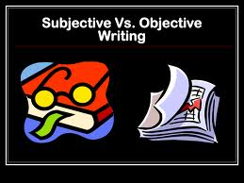
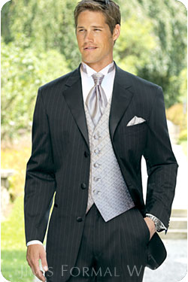
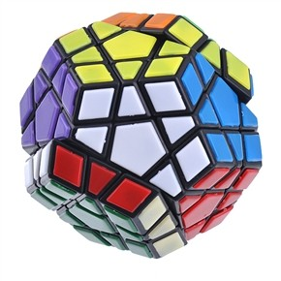
1. A reminder

Slide 6
1. A reminder
Some peculiarities:
full vs short forms
nouns vs verbs
passive vs active voice
concise vs informal vocabulary
rhetorical questions
connectors

Slide 7
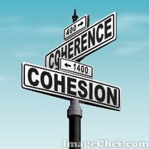
1. A reminder
”The writer must believe that what he is doing is the most important thing in the world. And he must hold to this illusion even when he knows it is not true.” John Steinbeck
responsibility
writer responsibility – achieved by

Slide 8
Exercise: Make this text cohesive
Lectures convey a large amount of information to a large number of students.
Lectures are cost-effective for universities.
University leaders favour lectures.
The information is not retained effectively by the students.
The information conveyed in smaller classes, tutorials or seminars, or by personal experience is retained more effectively than information from lectures.
Information from lectures is retained better if it is practised.

Slide 9
2. Types of cohesion in a text

Slide 10
2. Types of cohesion in a text
Marty and Pat, two college students, arrived at 7.00 a.m. Monday morning for their first day as part-time employees at the local chain restaurant (…) They were immediately met by Chris, the supervisor who interviewed them. Chris informed them that they must purchase company aprons for the job and that the cost ($8) would be deducted from their first paycheck. They received a brief ...

Slide 11
2. Types of cohesion in a text
Marty and Pat, two college students, arrived at 7.00 a.m. Monday morning for their first day as part-time employees at the local chain restaurant (...) They were immediately met by Chris, the supervisor who interviewed them. Chris informed them that they must purchase company aprons for the job and that the cost ($8) would be deducted from their first paycheck. They received a brief ...

Slide 12
2. Types of cohesion in a text
Marty and Pat, two college students, arrived at 7.00 a.m. Monday morning for their first day as part-time employees at the local chain restaurant...They were immediately met by Chris, the supervisor who interviewed them. Chris informed them that they must purchase company aprons for the job and that the cost ($8) would be deducted from their first paycheck. They received a brief...

Slide 13
2. Types of cohesion in a text
Reference words: they, their, them

Slide 14
2. Types of cohesion in a text
Marty and Pat, two college students, arrived at 7.00 a.m. Monday morning for their first day as part-time employees at the local chain restaurant (...) They were immediately met by Chris, the supervisor who interviewed them. Chris informed them that they must purchase company aprons for the job and that the cost ($8) would be deducted from their first paycheck. They received a brief ...

Slide 15
2. Types of cohesion in a text
Lexical relationships (related words): employees…, the job

Slide 16
2. Types of cohesion in a text
Marty and Pat, two college students, arrived at 7.00 a.m. Monday morning for their first day as part-time employees at the local chain restaurant (...) They were immediately met by Chris, the supervisor who interviewed them. Chris informed them that they must purchase company aprons for the job and that the cost ($8) would be deducted from their first paycheck. They received a brief ...

Slide 17
2. Types of cohesion in a text
Repetition: Chris, Chris

Slide 18
2. Types of cohesion in a text
Marty and Pat, two college students, arrived at 7.00 a.m. Monday morning for their first day as part-time employees at the local chain restaurant (...) They were immediately met by Chris, the supervisor who interviewed them. Chris informed them that they must purchase company aprons for the job and that the cost ($8) would be deducted from their first paycheck. They received a brief ...

Slide 19
2. Types of cohesion in a text
Ellipsis: aprons … the cost (of the aprons)

Slide 20
2. Types of cohesion in a text
Marty and Pat, two college students, arrived at 7.00 a.m. Monday morning for their first day as part-time employees at the local chain restaurant (...) They were immediately met by Chris, the supervisor who interviewed them. Chris informed them that they must purchase company aprons for the job and that the cost ($8) would be deducted from their first paycheck. They received a brief ...

Slide 21
2. Types of cohesion in a text
Reference words: they, their, them
Repetition: Chris, Chris
Lexical relatonships: employees…, the job
purchase, the cost
Ellipsis: aprons … the cost (of the aprons)

Slide 22
3. Cohesion vs coherence
cohesion: grammatical and lexical features that holds a piece of writing together; glue
coherence: concepts and relationships which link the sentences of a text; clear organisation and a logical sequence of ideas

Slide 23
3. Cohesion vs coherence
Cohesive or coherent or both?
”My favourite colour is blue. Blue sports cars go very fast. Driving in this way is dangerous and can cause many car crashes. I had a car accident once and broke my leg. I was very sad because I had to miss a holiday in Europe because of the injury.”
Cohesive but not coherent

Slide 24
3. Cohesion vs coherence
Cohesive or coherent or both?
”My favourite colour is blue. I'm calm and relaxed. In the summer I lie on the grass and look up.”
Coherent but not cohesive

Slide 25
3. Cohesion vs coherence
Cohesive or coherent or both?
”My favourite colour is blue. I like it because it is calming and it relaxes me. I often go outside in the summer and lie on the grass and look into the clear sky when I am stressed. For this reason, I'd have to say my favourite colour is blue.”
Cohesive and coherent

Slide 26
4. Cohesive devices
Reference:
"Some guys arrived. They seemed angry." (anaphora⬅)
"Listen to this: John's getting married." (cataphora➔)
Substitution: "I haven't got a pen. Do you have one?"
Ellipsis: "Where did you see him? _ In the street."
Lexical relationships:
- general to specific: "The flowers were lovely. She liked the tulips best."
- repeated forms: "Jack arrived. Jack was cross."
- comparison: "That house was bad. This one is even worse.”
- synonyms: „This guy is very bright and that one is smart too.”
Conjunctive relations (linking words): "I left early, but Mark stayed till the end."

Slide 27
4. Cohesive devices: Reference
For many years, East German people devised creative ways to sneak out of East Germany. Some people dug tunnels; others tried crashing through checkpoints with cars, trucks, or busses; still others flew out in small airplanes or balloons. One woman tied herself to the bottom of a car and passed through a checkpoint unnoticed. And one family sewed fake Russian uniforms for themselves; then, they pretended to be Russian soldiers and simply drove through a checkpoint. Some desperate people tried scrambling over a barbed-wire fence or a wall. These people were often shot.
Anaphoric or cataphoric reference?

Slide 28
4. Cohesive devices: Reference
For many years, East German people devised creative ways to sneak out of East Germany. Some people dug tunnels; others tried crashing through checkpoints with cars, trucks, or busses; still others flew out in small airplanes or balloons. One woman tied herself to the bottom of a car and passed through a checkpoint unnoticed. And one family sewed fake Russian uniforms for themselves; then, they pretended to be Russian soldiers and simply drove through a checkpoint. Some desperate people tried scrambling over a barbed-wire fence or a wall. These people were often shot.
Anaphoric reference; cataphoric reference

Slide 29
4. Cohesive devices: Reference
On 21 December 1972, the Basic Treaty was signed by East and West Germany, and relations between the two countries started to improve. During the next two decades, they began to cooperate with each other by sharing cultural and commercial activities such as arts exchange programs and joint business ventures. However, East Germans were still dissatisfied, for their living standard was lower than that of West Germany. Their industries produced inferior goods, and their country was polluted from inferior mining methods and careless industrial waste.
Anaphoric or cataphoric reference?

Slide 30
4. Cohesive devices: Reference
On 21 December 1972, the Basic Treaty was signed by East and West Germany, and relations between the two countries started to improve. During the next two decades, they began to cooperate with each other by sharing cultural and commercial activities such as arts exchange programs and joint business ventures. However, East Germans were still dissatisfied, for their living standard was lower than that of West Germany. Their industries produced inferior goods, and their country was polluted from inferior mining methods and careless industrial waste.
Anaphoric reference; cataphoric reference

Slide 31
4. Cohesive devices: Reference (pronouns)
What is the problem?
1. Mary told Laura that she was a good teacher.
2. We put the pizza box in the bin after we had finished eating it.
3. Although Mrs. Turner is wealthy, she does not spend it.
4. It was odd of it to say it.

Slide 32
4. Cohesive devices: Substitution and ellipsis
substitution is the replacement of one item by another
ellipsis is substitution by zero
Substitution:
E.g. Who ran to school? -> I did. (did = ran to school)
E.g. Who has a pen? -> I have one. (one = a pen)
Ellipsis:
E.g. Have you read much? -> I am trying to. (0 = read much)
E.g. I'll ask my dad about the pens and whether he has any.
(0 = pens)

Slide 33
4. Cohesive devices: Substitution or ellipsis?
The scientific study of memory began in the early 1870s when a German philosopher, Hermann Ebbinghaus, came up with the revolutionary idea that memory could be studied experimentally. In doing so he broke away from a 2000-year-old tradition that firmly assigned the study of memory to the philosopher rather than to the scientist.

Slide 34
Substitution

Slide 35
4. Cohesive devices: Substitution
The scientific study of memory began in the early 1870s when a German philosopher, Hermann Ebbinghaus, came up with the revolutionary idea that memory could be studied experimentally. In doing so he broke away from a 2000-year-old tradition that firmly assigned the study of memory to the philosopher rather than to the scientist.

Slide 36
4. Cohesive devices: Substitution or ellipsis?
Some of the water falls as rain flows on the surface as streams. Another part is evaporated. The remainder sinks into the ground and is known as ground water.
The 74 species of African antelope share certain basic features: all are exclusively vegetarian and bear one large calf each year.

Slide 37
Ellipsis

Slide 38
4. Cohesive devices: Ellipsis
Some of the water falls as rain flows on the surface as streams. Another part ………… is evaporated. The remainder ………….. sinks into the ground and is known as ground water.
The 74 species of African antelope share certain basic features: all ………. are exclusively vegetarian and ………. bear one large calf each year.

Slide 39
4. Cohesive devices: Substitution and ellipsis
1. His reputation was bigger than …….. Elvis.
2. While Japan’s development was rapid, ….. Singapore was even faster.
3. The first tourist's papers were in order, but …….. the remaining tourists were not.

Slide 40
4. Cohesive devices: Substitution and ellipsis
1. His reputation was bigger than that of Elvis.
2. While Japan’s development was rapid, that of Singapore was even faster.
3. The first tourist's papers were in order, but those of the remaining tourists were not.

Slide 41
4. Cohesive devices: Lexical cohesion
a way of achieving a cohesive effect: using the same or different words
repetition
synonyms
near synonyms
collocations
super/sub-ordinate relationships (e.g. fruit/apple, animal/cat) etc.

Slide 42
4. Cohesive devices: Lexical cohesion
The herring is a small, oily fish. Herrings are often tinned. Pickled herring is also popular. Herrings are popular in…
pluses:
easy to say/write (not much thinking), clear (unambiguous), maybe no true synonym exists
minuses:
boring, unnatural/childish sounding

Slide 43
4. Cohesive devices: Lexical cohesion
Synonyms: advantage, plus, benefit, pro
Lexically related words: job, employee, boss

Slide 44
4. Cohesive devices: Lexical cohesion: Synonyms (find them)
The period prior to joining an organization is called anticipatory socialization. During this time, individuals anticipate taking positions in one or more organizations. In the broadest sense, Marty and Pat were in the anticipatory socialization phase from the time they were born until they arrived at work that first Monday morning.

Slide 45
4. Cohesive devices: Lexical cohesion: Synonyms
The period prior to joining an organization is called anticipatory socialization. During this time, individuals anticipate taking positions in one or more organizations. In the broadest sense, Marty and Pat were in the anticipatory socialization phase from the time they were born until they arrived at work that first Monday morning.

Slide 46
4. Cohesive devices: Lexical cohesion: Synonyms
Differences in meaning between near synonyms
Positive/negative connotations:
“She's so slim!”
“She's so skinny!”
Old-fashioned and rare words:
Most students work hard, but not all of the scholars are diligent. Indeed, some pupils are lackadaisical.

Slide 47
4. Cohesive devices: Lexical cohesion: Synonyms in academic lg.
results – findings
area – field
authority – source
benefit – advantage
category – type
component – part
behaviour – conduct
output – production
expansion – increase
option – possibility
trend – tendency
drawback – disadvantage
assist – help
achieve – reach
concentrate – focus
show – demonstrate
found – establish
predict – forecast
retain – keep
strengthen – reinforce
eliminate – remove

Slide 48
4. Cohesive devices: Lexical cohesion: Synonyms linking this text
The chairman of the UK’s food standards agency has said that a national advertising campaign is necessary to raise low levels of personal hygiene. The organization is planning a £3m publicity programme to improve British eating habits. A survey has shown that half the population do not wash before eating, and one in five fail to wash before preparing food. There are over 6 million cases of food poisoning in this country every year, and the advertising blitz aims to cut this by 20%. This reduction, the food body believes, could be achieved by regular hand washing prior to meals.

Slide 49
4. Cohesive devices: Lexical cohesion: Synonyms linking this text
The chairman of the UK’s food standards agency has said that a national advertising campaign is necessary to raise low levels of personal hygiene. The organization is planning a £3m publicity programme to improve British eating habits. A survey has shown that half the population do not wash before eating, and one in five fail to wash before preparing food. There are over 6 million cases of food poisoning in this country every year, and the advertising blitz aims to cut this by 20%. This reduction, the food body believes, could be achieved by regular hand washing prior to meals.

Slide 50
4. Cohesive devices: Lexical cohesion: Synonyms linking this text
The chairman of the UK’s food standards agency has said that a national advertising campaign is necessary to raise low levels of personal hygiene. The organization is planning a £3m publicity programme to improve British eating habits. A survey has shown that half the population do not wash before eating, and one in five fail to wash before preparing food. There are over 6 million cases of food poisoning in this country every year, and the advertising blitz aims to cut this by 20%. This reduction, the food body believes, could be achieved by regular hand washing prior to meals.

Slide 51
4. Cohesive devices: Lexical cohesion: Synonyms linking this text
The chairman of the UK’s food standards agency has said that a national advertising campaign is necessary to raise low levels of personal hygiene. The organization is planning a £3m publicity programme to improve British eating habits. A survey has shown that half the population do not wash before eating, and one in five fail to wash before preparing food. There are over 6 million cases of food poisoning in this country every year, and the advertising blitz aims to cut this by 20%. This reduction, the food body believes, could be achieved by regular hand washing prior to meals.

Slide 52
4. Cohesive devices: Lexical cohesion: Collocations: words that “go together”
big | large | great
man house car dog smile problem surprise question difference boy | numbers part area company amount family population room eyes volume | success majority interest importance difficulty problem pleasure beauty artist surprise

Slide 53
5. Linking words (linkers)
- link clauses and sentences together
- show the relationships between them
- add information
- indicate a contrast or make a concession
- show a cause/effect relationship
- temporal linkers sequence parts of a text in a kind of
time order

Slide 54
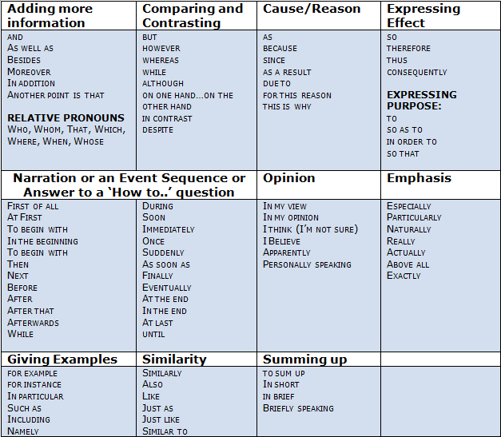

Slide 55
5. Linking words
Different linkers may have similar functions, but you cannot usually replace one linker with another without changing the meaning or grammar.
i.e. linkers are not interchangeable
Possible exceptions: despite and in spite of (despite is more common)

Slide 56
5. Linking words
“On the contrary...” : reinforces/underlines what was said before, by introducing an opposite idea.
Dr. Smith is not active at the university. On the contrary, he has been retired for 15 years.
“In contrast” makes a neutral contrast.
Butter and olive oil are expensive, but delicious. Margarine, in contrast, is cheap but foul tasting.

Slide 57
5. Linking words
“Although” contrast two ideas (clauses) in one sentence.
Although Jenny lived by the sea, she did not swim.
“However” contrasts ideas in two different sentences, however.
Jenny lived by the sea. Swimming, however, was not a hobby of hers.
It is grammatically correct to use “however” to contrast two parts of one sentence separated by a semi colon;

Slide 58
5. Linking words
“However” can come at the start of a sentence, after the subject, after the verb or at the end.
Stylistically, however, it is often best to put it after the subject. This is not always the case, however.
However, statistics show that putting “however” at the start of a sentence is much more common in English learners’ writing than in academic writing.

Slide 59
5. Linking words
Do not use “so” to start a sentence in formal writing.
*The semesters at BME are longer than at other universities in Hungary. So, BME students have less time for exam preparation or holidays.
In academic writing use instead: “therefore”, or “thus”

Slide 60
5. Linking words
I have come to the conclusion that I no longer enjoy the full support of the board. I have therefore decided to resign.
Fewer pupils will attend the schools, and they will thus need fewer teachers.
“Thus” can also mean “in the way or by the method just mentioned”
The producers will raise their prices, thus increasing their profits.

Slide 61
5. Linking words
Some linkers simply add new information or points: and, in addition, also
(remember, you can also use “other”, “another”, “further” to add points)
Other less common linkers (furthermore, moreover, besides) add new information or a final point which is more important or a more powerful argument than what was said before.
Tom's dog is very slow, as it is quite old. Besides, it is sick.

Slide 62
5. Linking words
Common: First, Second, Third, Finally, Next, then, “the final/last….is..”
Rarer: Firstly, Secondly, Thirdly, Lastly
Very rare: “First of all”, “last but not least”
AVOID THE LATTER

Slide 63
… and finally …

Slide 64
Exercise: Make this text cohesive
Lectures convey a large amount of information to a large number of students.
Lectures are cost-effective for universities.
University leaders favour lectures.
The information is not retained effectively by the students.
The information conveyed in smaller classes, tutorials or seminars, or by personal experience is retained more effectively than information from lectures.
Information from lectures is retained better if it is practised.

Slide 65
Exercise: Make this text cohesive
There are two reasons why university leaders favour lectures. One is that lectures convey a large amount of information to a large number of students. The other is that lectures are cost-effective for universities. However, what is good for leaders is not necessarily beneficial for students. The information from lectures is not retained effectively by the students because they cannot practise it. Therefore, the information conveyed in smaller classes, tutorials or seminars, or by personal experience is more useful for students.

Slide 66
Bibliography
Bailey, Stephen (2011) Academic Writing: A Handbook for International Students Oxford: Routledge
Macmillan English Dictionary for Advanced Learners, “Improve your Writing Skills” section.
http://gordonscruton.blogspot.hu/2011/08/what-is-cohesion-coherence-cambridge.html
http://www.utbildning.gu.se/digitalAssets/1389/1389265_academic-writing-ht-12-natfak.pdf
http://linguapress.com/grammar/points/demonstratives.htm

Slide 67

Thank you. Enjoy your day!

